Slide 1

movie analysis
MICROSOFT RESEARCH MOVIE ANALYSIS

Slide 2
Overview
The movie industry, a significant and profitable global sector, has captivated audiences for over a century.
Key players include genre, actors, and producers.
Microsoft, a technology firm, offers operating systems, cloud services, developer tools, and cybersecurity solutions.

Slide 3

Business Understanding
Microsoft plans to launch a new movie company, despite lacking experience in film production.
The research aims to identify the best box office genres, identify trends in movie popularity, and determine if higher production budgets correlate with higher revenue.
Key attributes include the release month, highest-rated movies, and production budgets. The goal is to guide the company's film production.

Slide 4
Objectives
Are there specific months or seasons when movies tend to perform better?
Are there any noticeable trends in movie popularity?
Is higher production budget correlated with higher revenue?

Slide 5
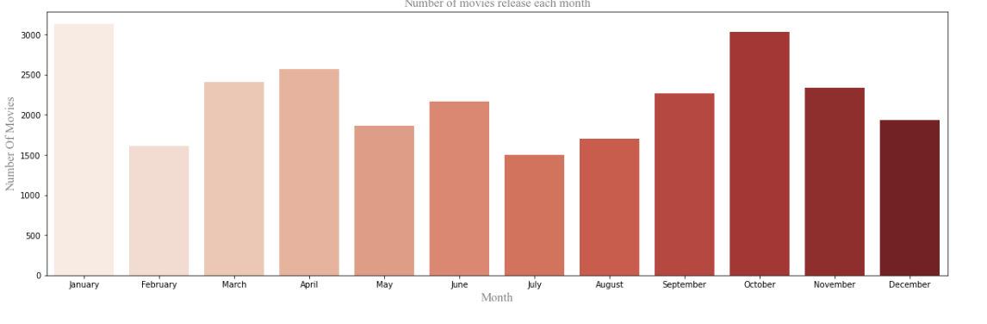
DATA ANALYSIS
The year with the most movie releases is 2015, and the month with the most releases is January.
It implies that 2015 experienced a lot of new movie releases, with January being especially active.

Slide 6
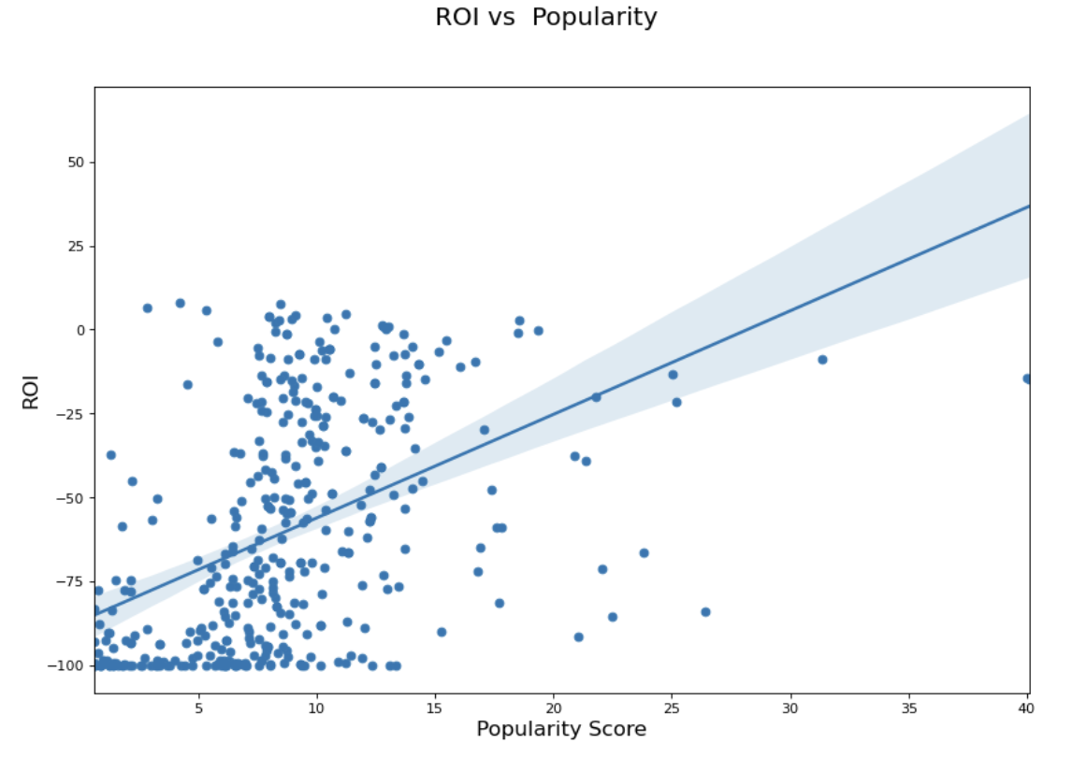
The correlation between ROI and Popularity is linear Therefore the change in popularity score affects ROI.

Slide 7
Recommendation and Conclusions
In 2015, January saw the highest number of movie releases, possibly indicating a specific trend in the movie industry during that time.
High budget movies are most popular due to high production quality, marketing, and promotions, with a positive correlation between budget size and audience popularity.

